Slide 1
Design and Development
Paradigms and common models

Slide 2

Utilising The formal process of Development
Turns our software process form a unformed chaos with low chance of success into a well ordered shareable software solution.

Slide 3
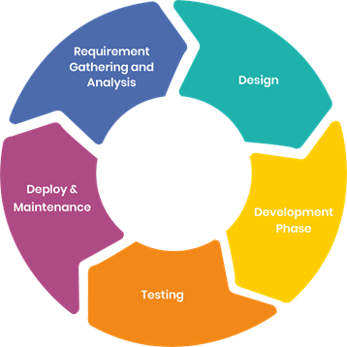

Slide 4
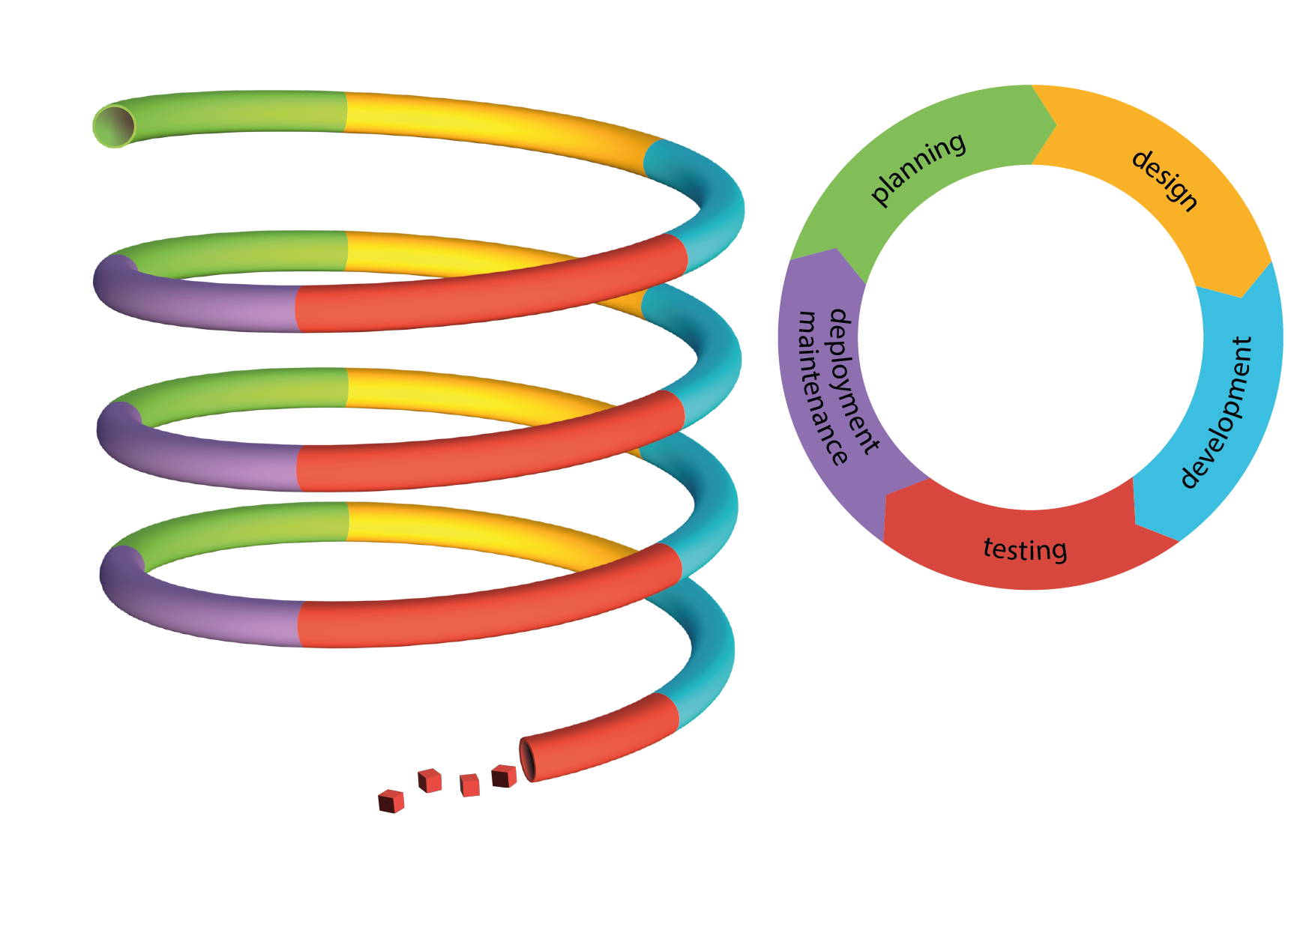
SDLC
Iterations build software over time until the cost of the next phase exceeds the cost we are willing to pay.

Slide 5
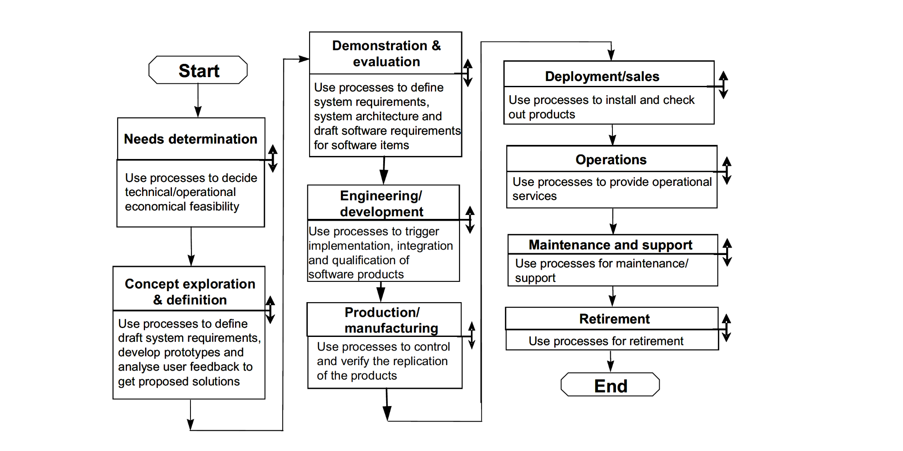

Slide 6
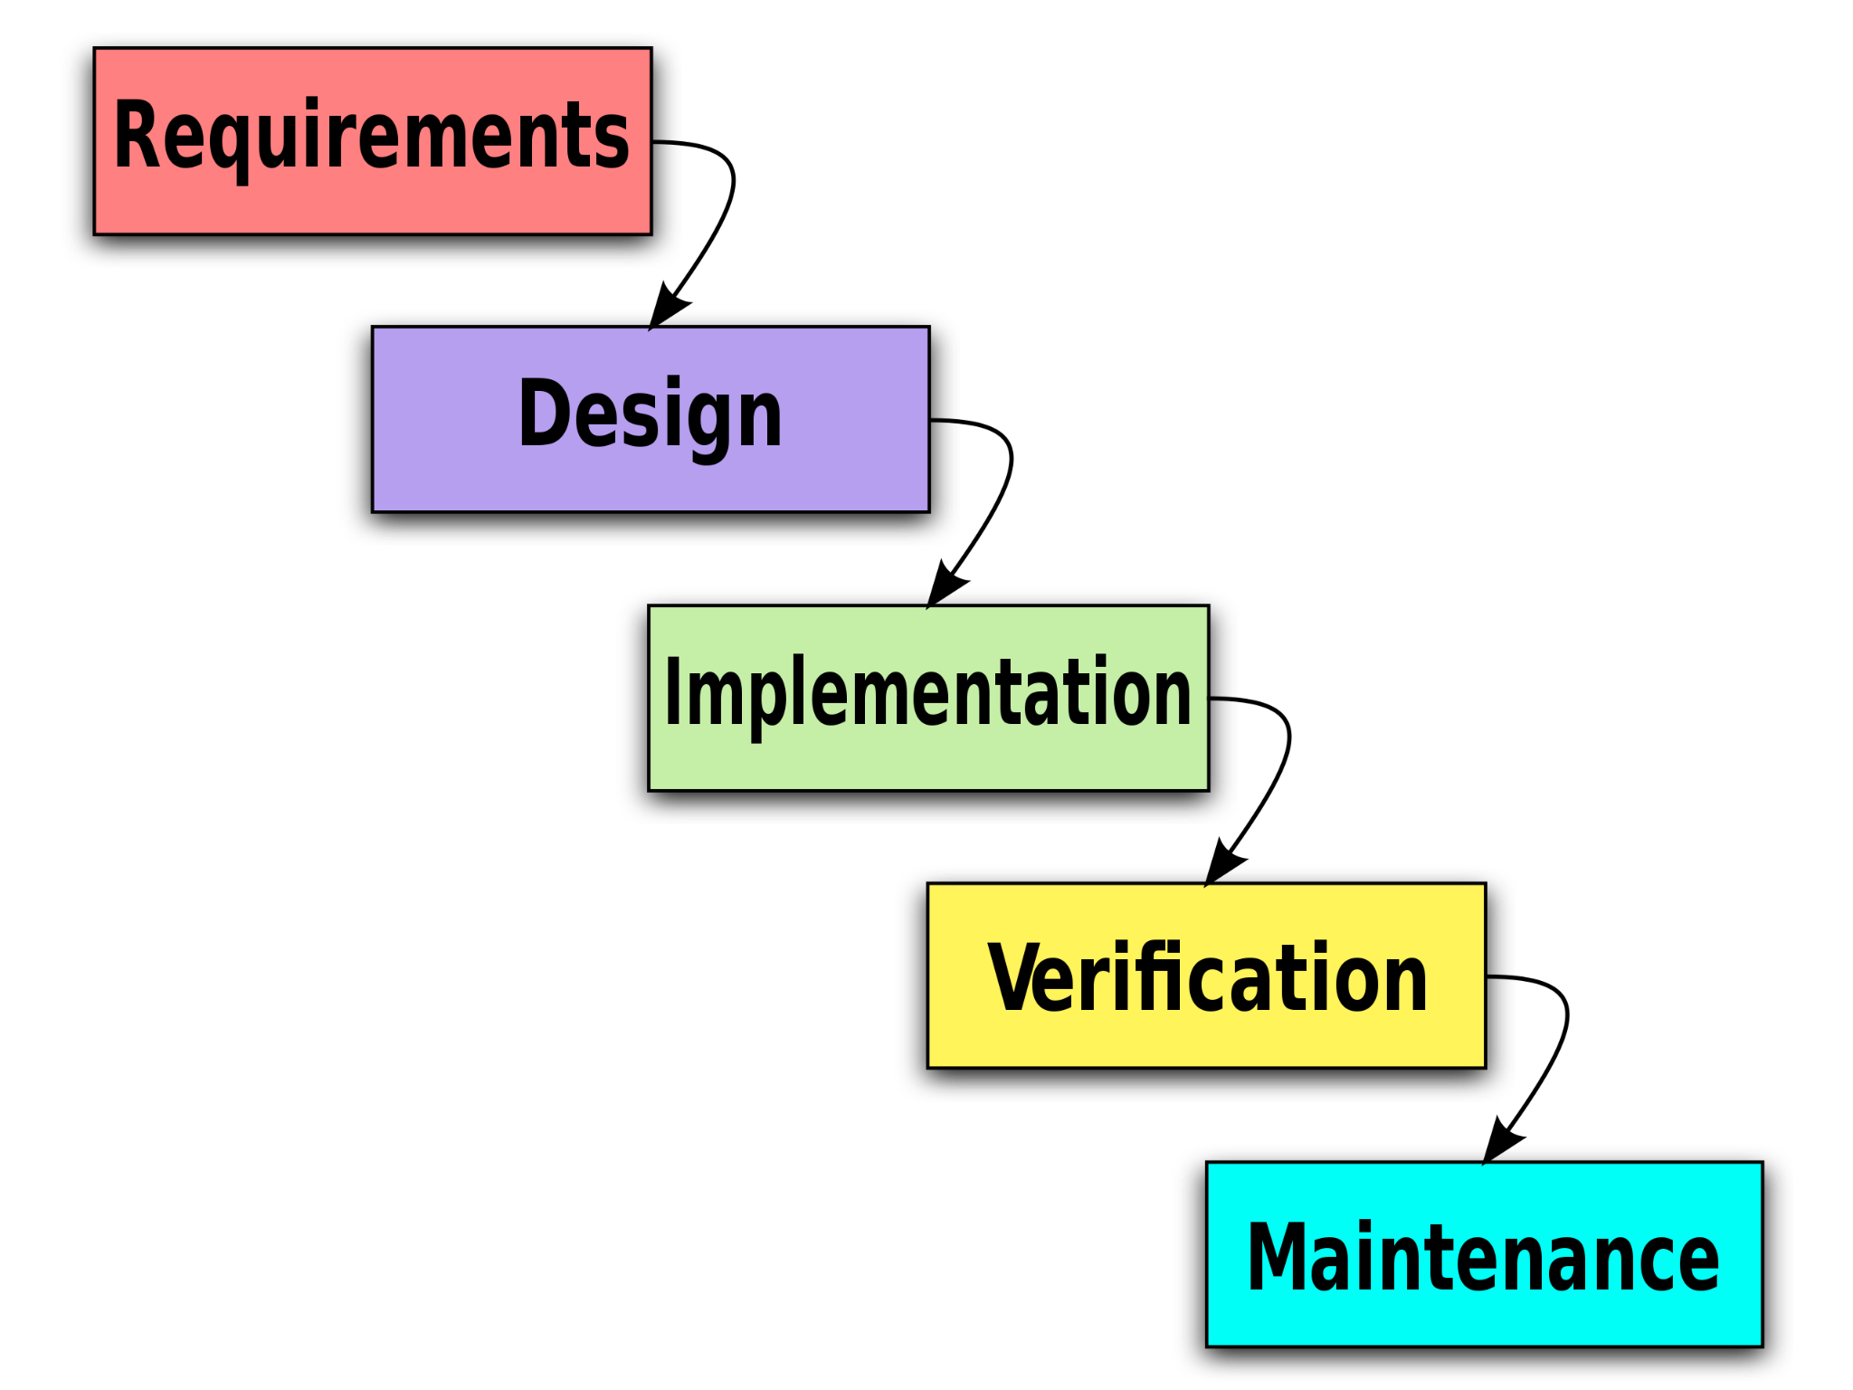

Slide 7
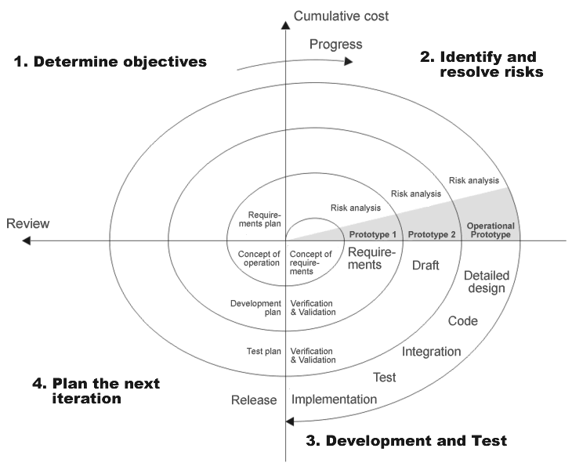

Slide 8
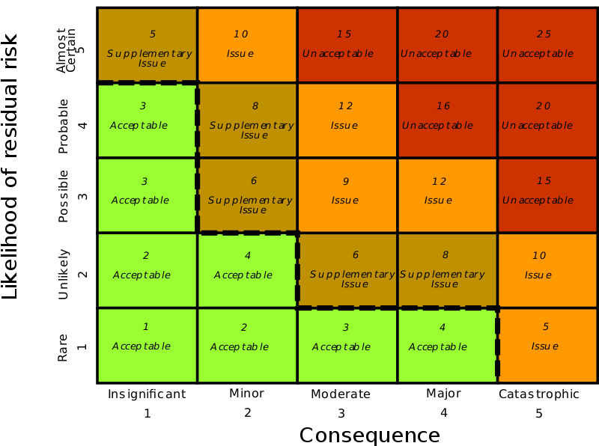
Risk analysis

Slide 9
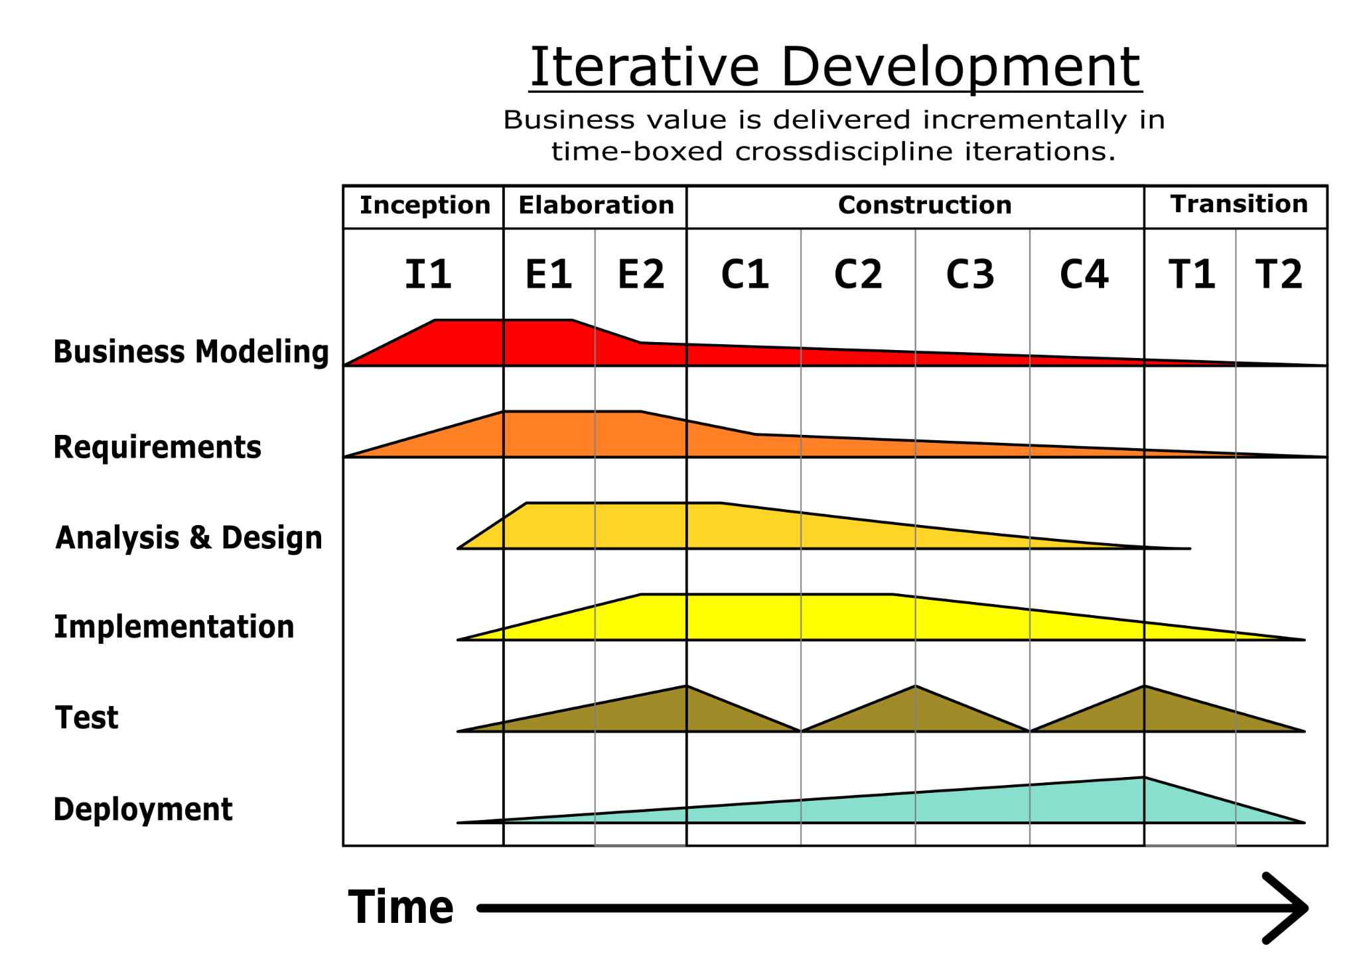

Slide 10
Rapid Application Development process
Prototype
User Design
Analysis and quick design
Testing & Turnover
Application generation
Refine
Test

Slide 11
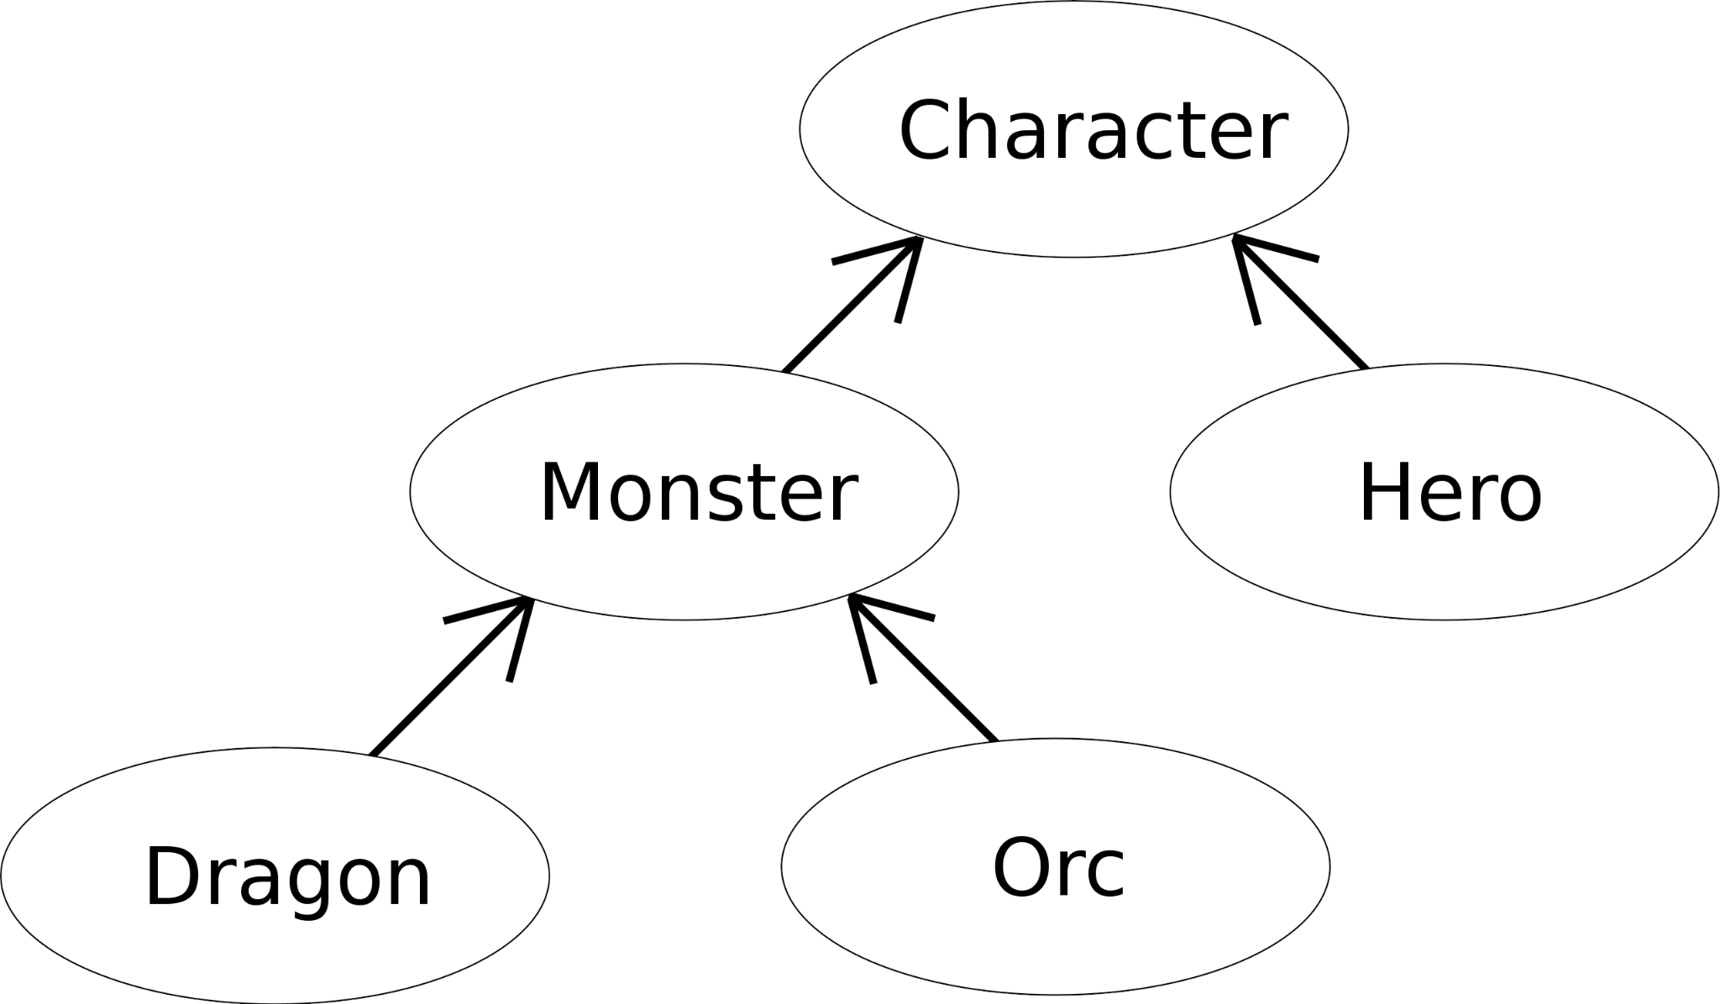

Slide 12
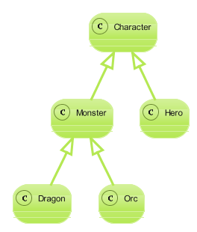
Class Diagram

Slide 13
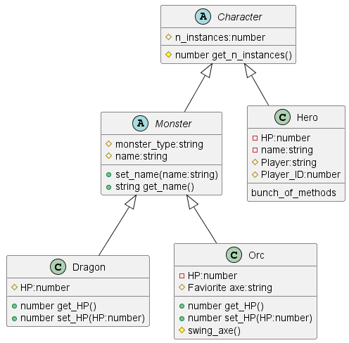

Slide 14
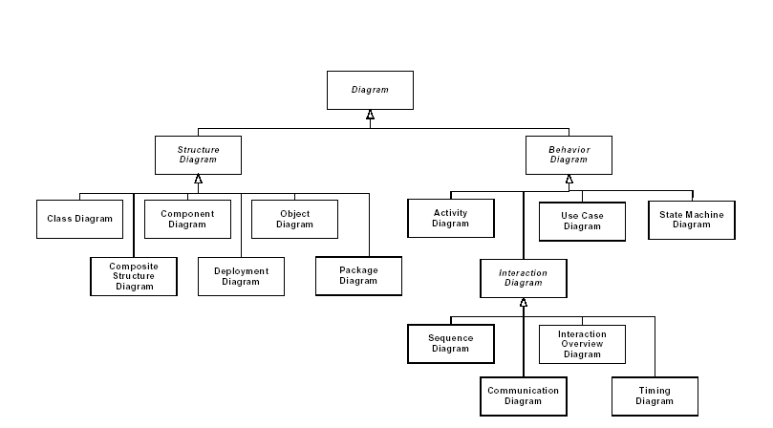
Schema of UML diagram types

Slide 15
Bubble Sort
bubble( array ):
for each element in array:
for each element i in array:
if array[i] > array[i+1]: swap array[i] and array[i+1]

Slide 16
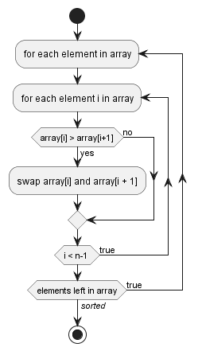
```plantuml
@startuml
!pragma useVerticalIf on
start
repeat:for each element in array;
repeat:for each element i in array;
if (array[i] > array[i+1]) then (yes)
:swap array[i] and array[i + 1];
else (no)
endif
repeat while (i < n-1 ) is (true)
repeat while (elements left in array) is (true) not (//sorted//)
stop
@enduml
```

Slide 17
Needleman-Wunsch pseudocode for calculating F:
for i in length(A):
F(i,0) = p * i
for j in length(B):
F(0,j) = p * j
for i in length(A):
for j in length(B):
match = F(i-1, j-1) + S(A(i), B(j))
delete = F(i-1, j) + p
insert = F(i, j-1) + p
F(i,j) = max(match, delete, insert)
Needleman-Wunsch pseudocode for calculating the alignment:
i = length(A)
j = length(B)
while ( i>0 and j>0 ):
if (i>0 and j>0 and F(i, j) == F(i−1, j−1) + S(A(i), B(j)))
// match! Or
alignA = A(i) + alignA
alignB = B(j) + alignB
i = i − 1
j = j − 1
else if (i > 0 and F(i, j) == F(i−1, j) + d)
// insertion in A or deletion in B
alignA ← A(i) + alignA
alignB ← "−" + alignB
i = i − 1
else
// deletion in A or insertion in B
alignA ← "−" + alignA
alignB ← B(j) + alignB
j = j − 1
}
}

